Slide 1
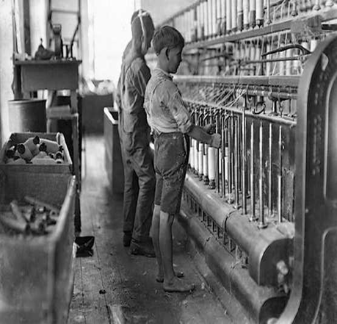
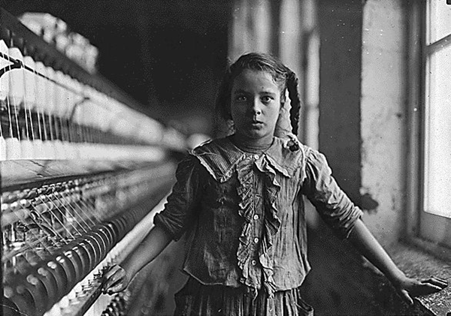
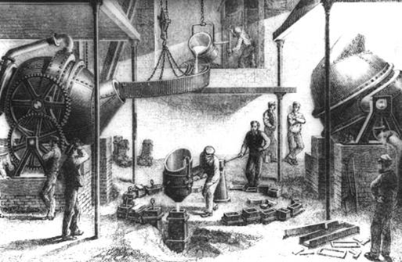
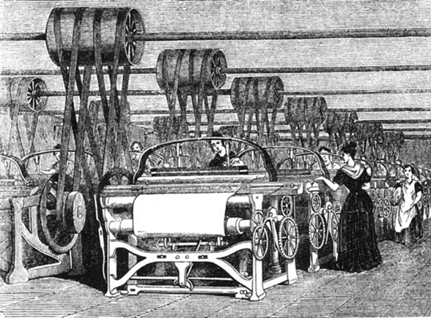
The Industrial Revolution 1700-1900

Slide 2
What comes to mind?
Create a list of three words or short phrases that describe the Industrial Revolution. When did the revolution take place?

Slide 3
Interact with History
You are a 15-year-old living in England where the Industrial Revolution has spurred the growth of thousands of factories. Cheap labor is in great demand. Like millions of other teenagers, you do not go to school. Instead, you work in a factory 6 days a week, 14 hours a day. The small pay you receive is need to help support your family. You trudge to work before dawn every day and work until after sundown. Inside the workplace the air is hot and foul, and after sunset it is so dark it is hard to see. Minding the machines is exhausting, dirty, and dangerous.

Slide 4
Industrial Revolution
http://www.youtube.com/watch?v=tGbU5T25tPE
http://www.youtube.com/watch?v=7QL_uG2GSZo

Slide 5
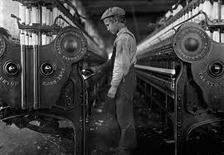
Respond to the Following:
Would you attempt to change your working conditions in the factory? If so, how?
Would you join a union, go to school, or run away. Explain your response.

Slide 6
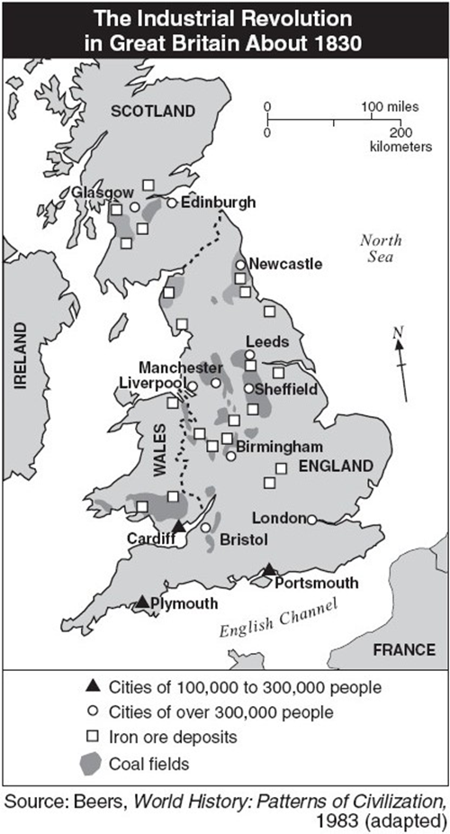
The Beginnings of Industrialization
Benefits of Great Britain?
Geography?
Cities?
Population?
Natural Resources?
The Industrial Revolution starts in England and soon spreads to other countries.

Slide 7
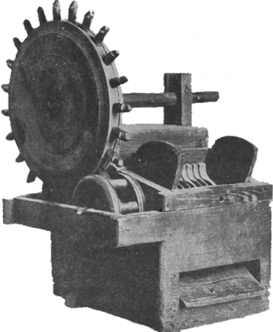
New Ways of Working
Industrial Revolution: greatly increases output of machine-made goods
Revolution begins in England in the middle 1700s
The Agricultural Revolution Paves the Way
Enclosures: large farm fields enclosed by fences or hedges
Wealthy landowners buy, enclose land once own by village farmers
Enclosures allow experimentation with new agricultural methods

Slide 8
Rotating Crops
Crop rotation: switching crops each year to avoid depleting the soil
Livestock breeders allow only the best to breed, improve food quality

Slide 9
Why the Industrial Revolution Began in England
Industrialization: move to machine production of goods
Britain has natural resources –coal, iron, rivers, harbors
Expanding economy in Britain encourages investment
Britain has all needed factors of production –land, labor, capital

Slide 10
Changes in the Textile Industry
Weavers work faster with flying shuttles and spinning jennies
Water frame uses water power to drive spinning wheels
Power loom, spinning mule speed up production, improve quality
Factories: buildings that contain machinery for manufacturing
Cotton gin boosts American cotton production to meet British demand

Slide 11
Improvements in Transportation
Watt’s Steam Engine
Need for cheap, convenient power spurs development of steam engine
James Watt improves steam engine, financed by Matthew Boulton
Boulton an entrepreneur: organizes, manages, takes business risk
Water Transportation
Robert Fulton builds first steamboat, the Clermont, in 1807
England’s water transport improved by system of canals
Road Transportation
British roads are improved; companies operate them as toll roads

Slide 12
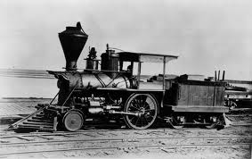
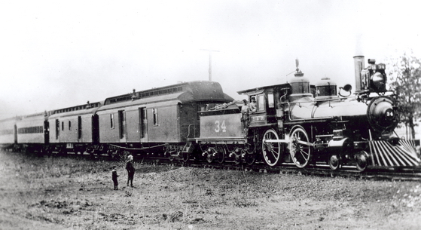
The Railway Age Begins
Steam-Driven Locomotives
In 1804, Richard Trevithick builds first steam-down locomotive
In 1825, George Stephenson builds world’s first railroad line
The Liverpool-Manchester Railroad
Entrepreneurs build railroad from Liverpool to Manchester
Stephenson’s Rocket acknowledged as best locomotive (1829)

Slide 13
Industrialization
The factory system changes the way people live and work, introducing a variety of problems.

Slide 14
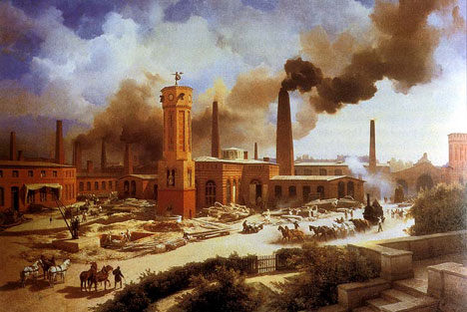
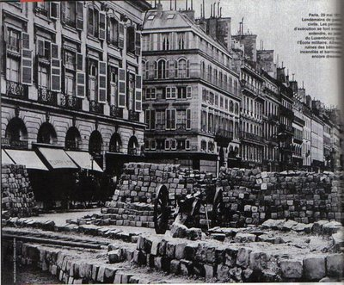
Industrialization Changes Life
Factory Work
Factories pay more than farms, spur demand for more expensive goods
Industrial Cities Rise
Urbanization: city-building and movement of people to cities
Growing population provides workforce, market for factory goods
British industrial cities: London, Birmingham, Manchester, Liverpool

Slide 15
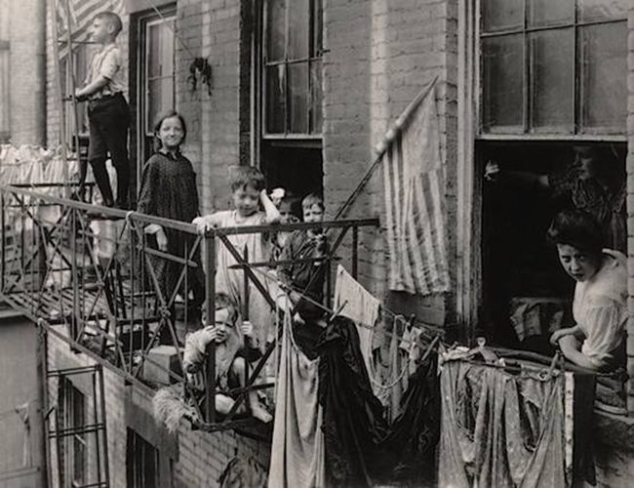
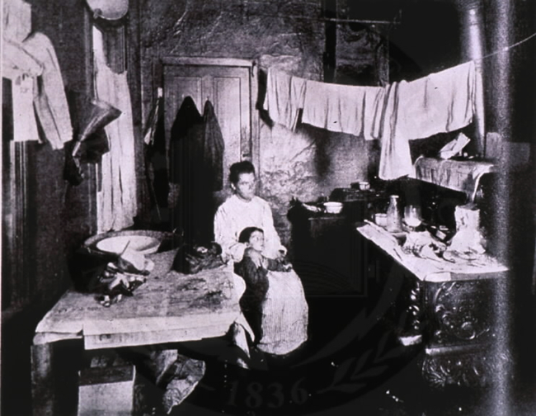
Living Conditions
Sickness widespread; epidemics, like cholera, sweep urban slums
Life span in one large city is only 17 years
Wealthy merchants, factory owners live in luxurious suburban homes
Rapidly growing cities lack sanitary codes, building codes
Cities also without adequate housing, education, police protection

Slide 16
Working Conditions
Average working day 14 hours for 6 days a week, year round
Dirty, poorly lit factories injure workers
Many coal miners killed by coal dust

Slide 17
Class Tension Grows
The Middle Class
Middle class: skilled workers, merchants, rich farmers, professionals
Emerging middle class looked down on by landowners, aristocrats
Middle class has comfortable standard of living
The Working Class
Laborers’ lives not improved; some laborers replaced by machines
Luddites, other groups destroy machinery that puts them out of work
Unemployment a serious problem; unemployed workers riot

Slide 18
Positive-Immediate Benefits
Creates Jobs, enriches nations, encourages technological progress
Education expands, clothing cheaper, diet and housing improve
Workers eventually win shorter hours, better wages and conditions
Long-Term Effects
Improved living and working conditions still evident today
Governments use increased tax revenues for urban improvements

Slide 19
Industrialization Spreads
The industrialization that begins in Great Britain spreads to other parts of the world.

Slide 20
Industrialization in the United States
U.S. has natural and labor resources needed to industrialize
Samuel Slater, English textile worker, builds textile mill in U.S.
Lowell, Massachusetts a mechanized textile center by 1820
Manufacturing towns spring up around factories across the country
Young single women flock to factory towns, work in textile mills
Clothing, shoemaking industries soon mechanize

Slide 21
Industrialization in the United States
Later Expansion of U.S. Industry
Industrialization picks up during post-Civil War technology boom
Cities like Chicago expand rapidly due to location on railroad lines
Small companies merge to form larger, powerful companies
The Rise of Corporations
Stock: limited ownership rights for company, sold to raise money
Corporation: company owned by stockholders, share profits not debts
Large corporations attempt to control as much business as they can

Slide 22
Continental Europe Industrializes
Troubles in Continental Europe
Revolution and Napoleonic wars disrupted early 19th century economy
Beginnings in Belgium
Belgium has iron ore, coal, water transportation
British workers smuggle in machine plans, start companies (1799)

Slide 23
Continental Europe Industrializes
Germany Industrializes
Political, economic barriers; but industry, railroads boom by mid-century
Expansion Elsewhere in Europe
Bohemia develops spinning; Northern Italy mechanizes silk textiles
Industrialization in France more measured; agriculture remains strong

Slide 24
The Impact of Industrialization
Rise of Global Inequality
Wealth gap widens; non-industrialized countries fall further behind
European nations, U.S., Japan exploit colonies for resources
Imperialism spreads due to need for raw materials, markets
Transformation of Society
Europe and U.S. gain economic power
African and Asian economies lag, based on agriculture, crafts
Rise of middle class strengthens democracy, calls for social reform

Slide 25
Reforming the Industrial World
The Industrial Revolution leads to economic, social, and political reforms.

Slide 26
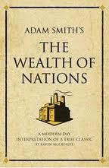
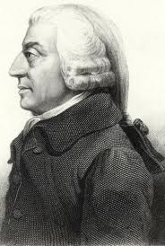
Laissez-faire Economics
Laissez-faire: economic policy of not interfering with businesses
Originates with Enlightenment economic philosophers
Adam Smith: defender of free markets, author of The Wealth of Nations
Believes economic liberty guarantees economic progress
Economic natural laws: self-interest, competition, supply and demand

Slide 27
The Economists of Capitalism
Thomas Malthus, David Ricardo boost laissez-faire capitalism
Capitalism: system of privately own businesses seeking profits
Malthus thinks populations grow faster than food supply
Wars, epidemics kill off extra people or misery and poverty result
Ricardo envisions a permanent, poor underclass providing cheap labor

Slide 28
The Rise of Socialism
Utilitarianism
Jeremy Bentham’s utilitarianism: judge things by their usefulness
John Stuart Mill favors regulation to help workers, spread wealth
Utopian Ideas
Robert Owen improves workers’ conditions, rent cheap housing
In 1824, Owen founds utopian community, New Harmony, Indiana
Socialism
Factors of production owned by, operated for the people
Socialists think government control can end poverty, bring equality

Slide 29
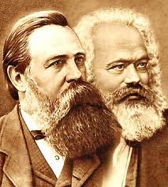
Marxism: Radical Socialism
Marxism’s Prophets
Karl Marx: German journalist proposes radical socialism, Marxism
Friedrich Engels: German whose father owns and operates Manchester textile mill
The Communist Manifesto
Marx and Engels believe society is divided into warring classes
Capitalism helps “haves,” the employers known as the bourgeoisie
Hurts “have-nots,” the workers known as the proletariat
Marx, Engels predict the workers will overthrow the owners

Slide 30
The Future According to Marx
Marx believes that capitalism will eventually destroy itself
Inequality would cause workers to revolt, seize factories and mills
Communism: society where people own, share the means of production
Marx’s ideas later take root in Russia, China, Cuba
Time has shown that society not controlled by economic forces alone

Slide 31
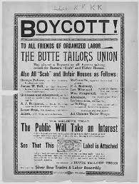
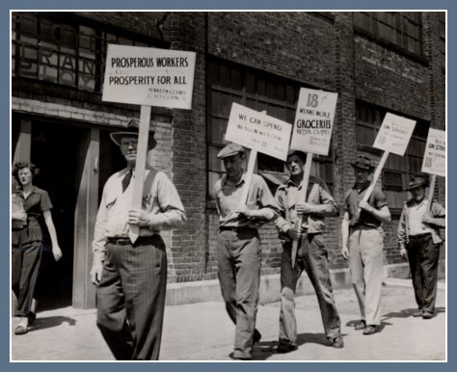
Labor Unions and Reform Laws
Unions: associations formed by laborers to work for change
Unions negotiate for better pay, conditions with employers
Sometimes they strike (call a work stoppage) to pressure owners
Skilled workers are first to form unions
Movement in Britain, U.S. must fight for right to form unions
Union goals were higher wages, shorter hours, improved conditions

Slide 32
Reform Laws
British, U.S. laws passed to stop worst abuses of industrialization
1842 Mines Act in Britain stops women, children, working underground
In 1847, workday for women, children limited to 10 hours in Britain
U.S. ends child labor, sets maximum hours in 1904

Slide 33
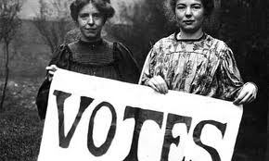
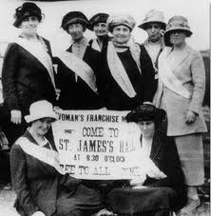
The Reform Movement Spreads
The Abolition of Slavery
In 1833, reformers help end slavery in British empire
Slavery ends in U.S. in 1865; ends by 1888 in rest of Americas
The Fight for Women’s Rights
Women pursue economic and social rights as early as 1848
International Council for Women founded in 1888; worldwide membership

Slide 34
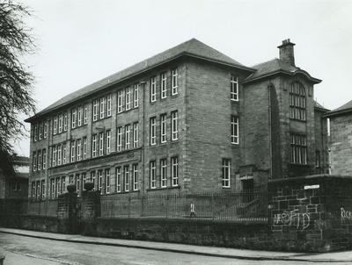
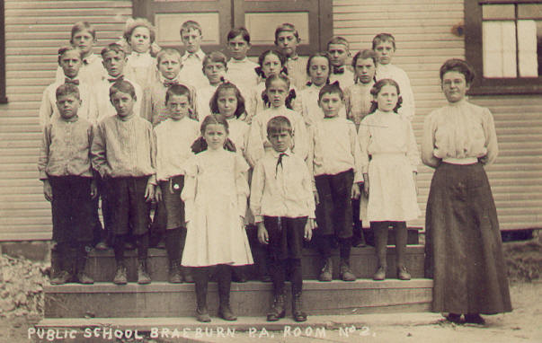
Reforms Spread to Many Areas of Life
Reformers establish free public schools in Europe in late 1800s
Public schools common in U.S. by 1850s; prison reform also sought

